Slide 1



How UML Will Save Your Life
Jay Ashbaugh

Slide 2

Agenda
Project
Context
Use Case
Sequence
Data Flow
ERD
Class

Slide 3
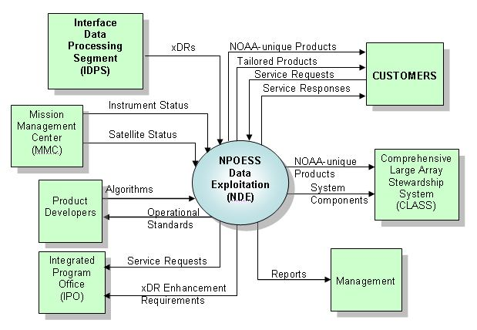
Context Diagram

Slide 4
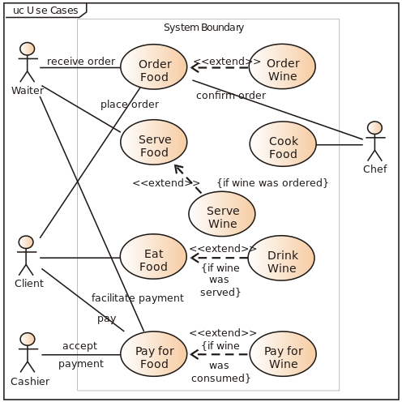
Use Case Diagram

Slide 5
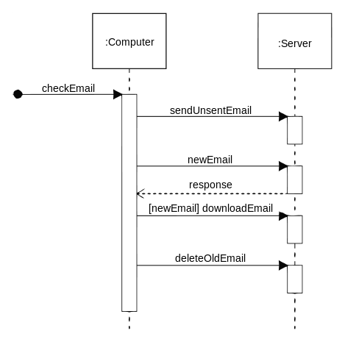
Sequence Diagram

Slide 6
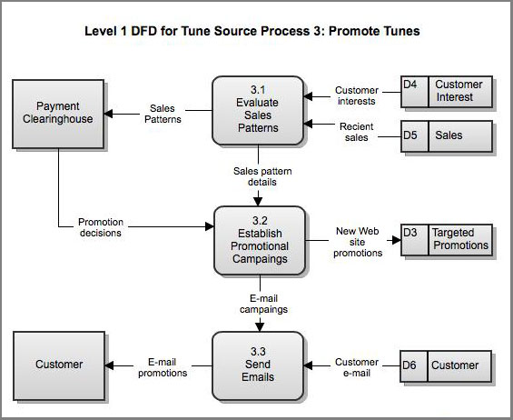
Data Flow Diagram

Slide 7
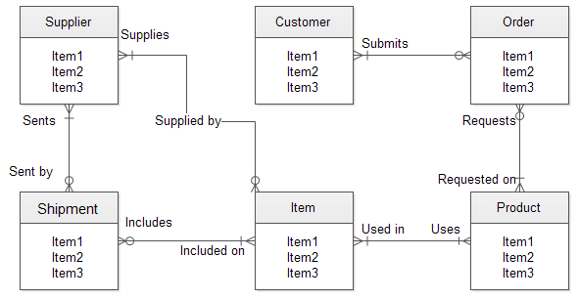
ERD Diagram

Slide 8
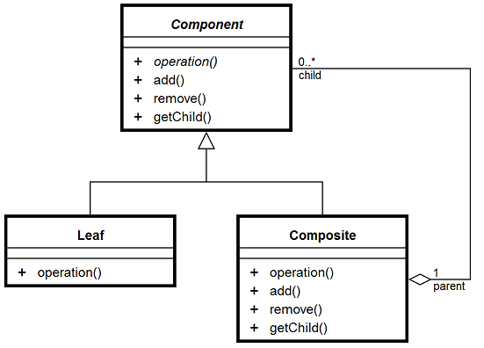
Class Diagram

Slide 9

Jay Ashbaugh
Software Development Manager
Valorem Consulting | 2101 Broadway, Suite 31 | Kansas City, MO 64108
855.864.9929 Office
816.738.0335 Mobile
Jay.Ashbaugh@valoremconsulting.com | valoremconsulting.com
LinkedIn: www.linkedin.com/in/jayashbaugh
Tweeter: @TEAMAshbaugh

Slide 10








Obrigado
Gracias
Thank You
Danke
Grazie
Merci

